Slide 1

Historical Summer Olympic Analysis
By:
Julian Kim, Brandon Hayes, Fei Meng, and Rosa Munoz

Slide 2
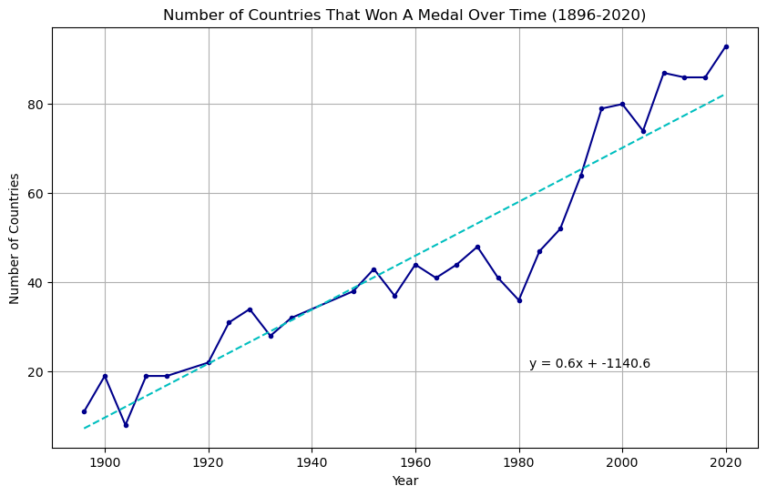
How has the addition of new countries affected the Olympics?
Number of countries that won at least one medal
No datapoint for 1940 and 1944
77 countries medaled in 2024 Summer Olympics¹
Predicts 84 countries to win a medal
1 - https://olympics.com/en/paris-2024/medals

Slide 3
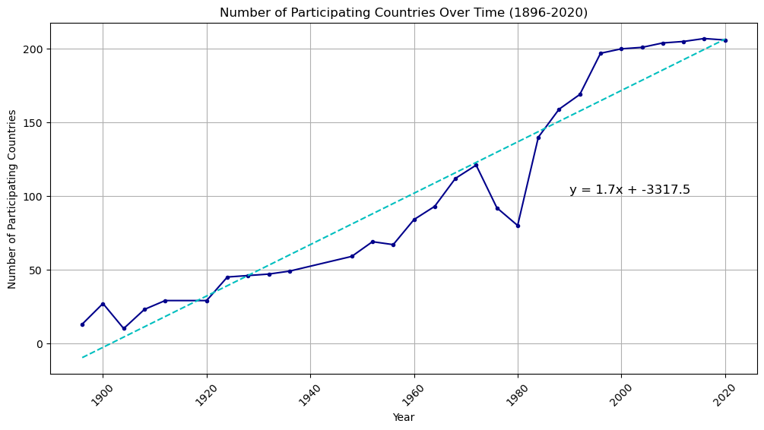
How has the addition of new countries affected the Olympics?
Number of countries participating
206 countries participated in 2024 Summer Olympics¹
Predicts 214 countries
1 - https://olympics.com/ioc/faq/competing-and-being-part-of-the-games/how-many-athletes-and-countries-take-part-in-the-olympic-games

Slide 4
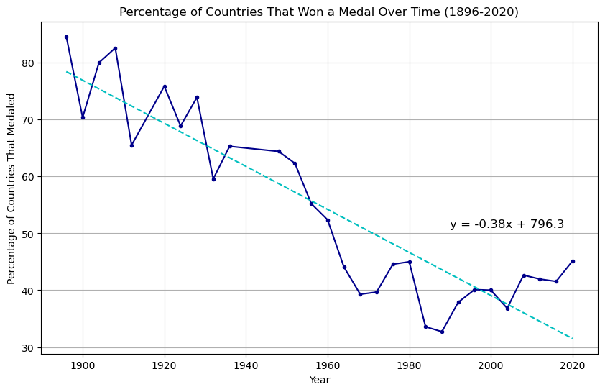
How has the addition of new countries affected the Olympics?
Dividing number of countries that won a medal by number of participating countries
38% of countries won a medal in 2024 Summer Olympics
Predicts 27% of countries

Slide 5
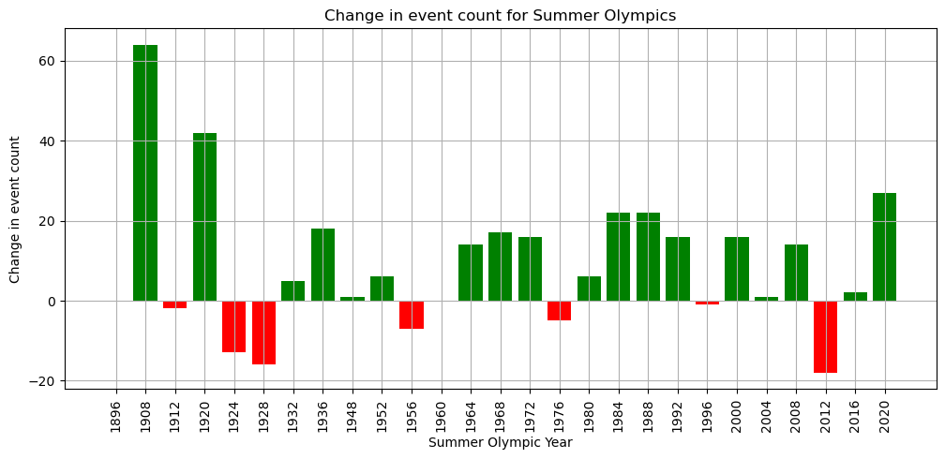
How has the addition of new events affected the Olympics?
The change in total Olympic events from one summer event to the next.
Two events had to be cleaned due to inaccurate data. (1900 and 1904)
18 of the changes were positive addition of events.
The trend of increasing events continued with 329 in 2024.

Slide 6
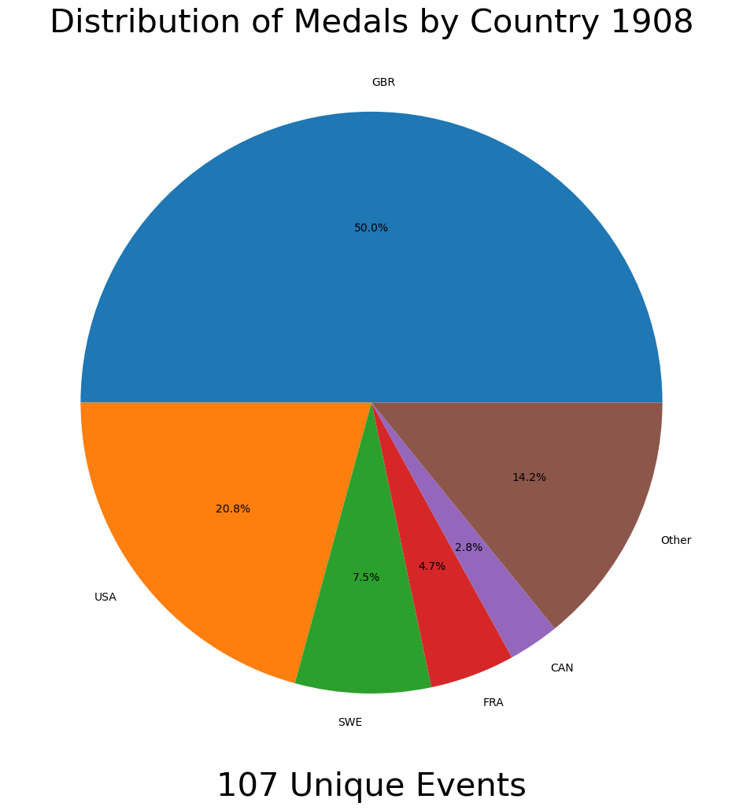
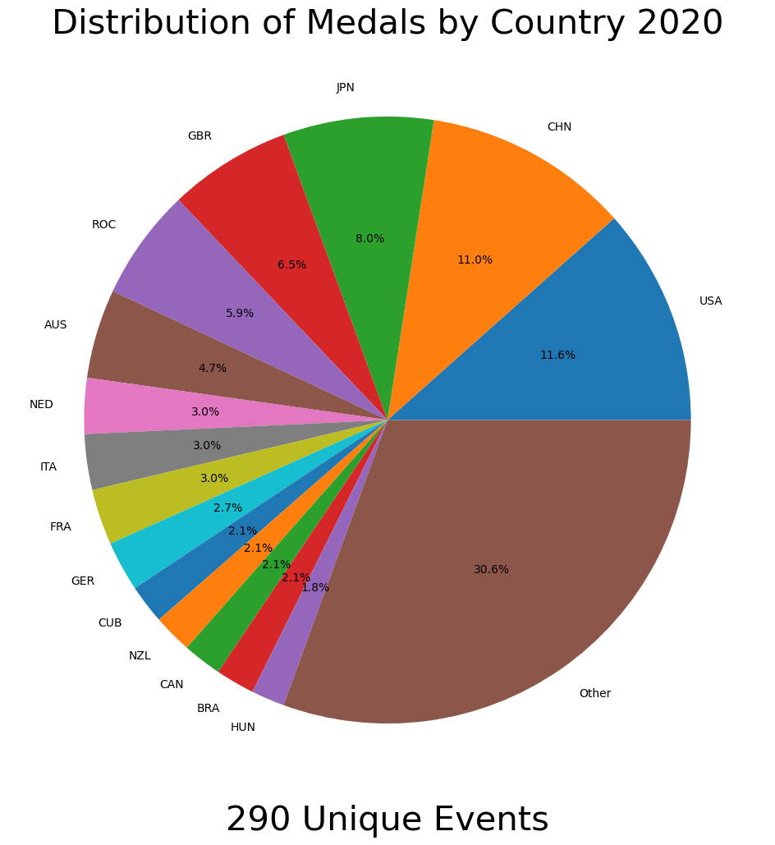
How has the addition of new events affected the Olympics? (part 2)
Top 5 for 1908 equated for 85.8% of gold medals.
Top 15 for 2020 equated for 69.6% of gold medals

Slide 7
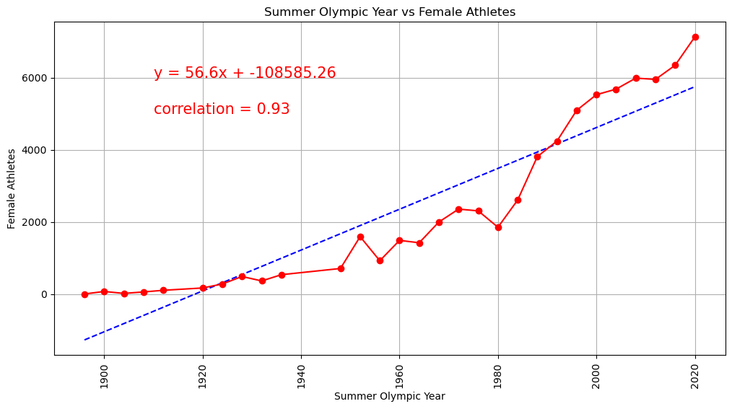
Have there been more female athletes added over time?
Number of female athletes who participated.
Prediction: 5,973 female athletes in 2024 Summer Olympics.
Actual value : 5,503 female athletes in 2024 Summer Olympics.
Correlation of 0.93 suggest strong relationship between female athletes participating and the passage of time.

Slide 8
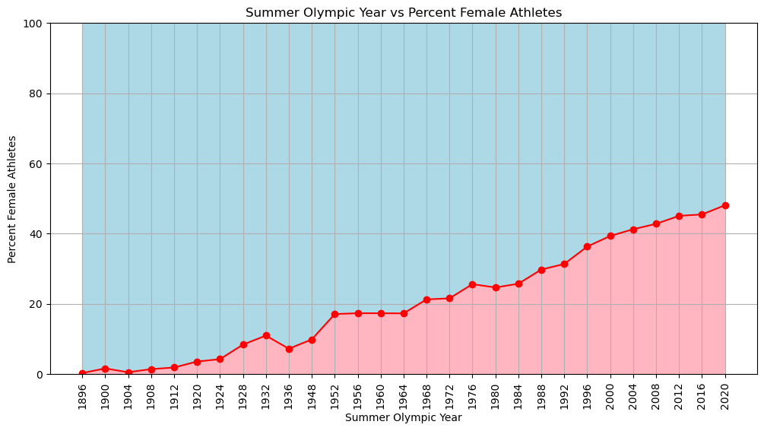
Have there been more female athletes added over time? (Part 2)
Depicts the percentage of athletes that were female.
Key takeaway
It took from 1896 to 1976 to pass 25% of athletes were female. (80 years)
From 1976 to 2020 female athletes gained another 23% to achieve 48% proportion. (44 years)

Slide 9
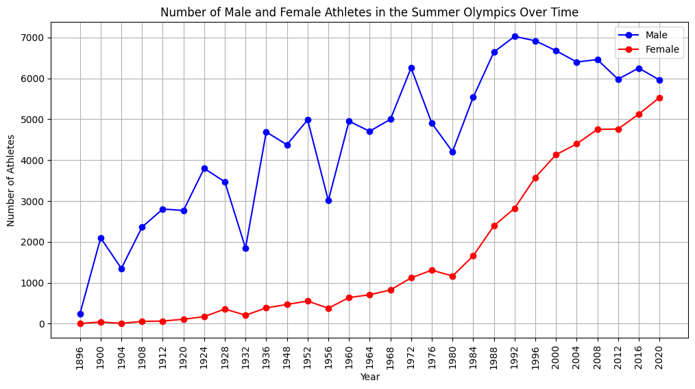
Relevance of Gender
Traditionally, sport has been dominated by men, both in terms of participation and governance. Worldwide, women’s participation rates in sporting activities are lower than men’s. Yet over the last 20 years significant changes have occurred and the difference in involvement between the genders is becoming narrower.
Sport | European Institute for Gender Equality (europa.eu)

Slide 10
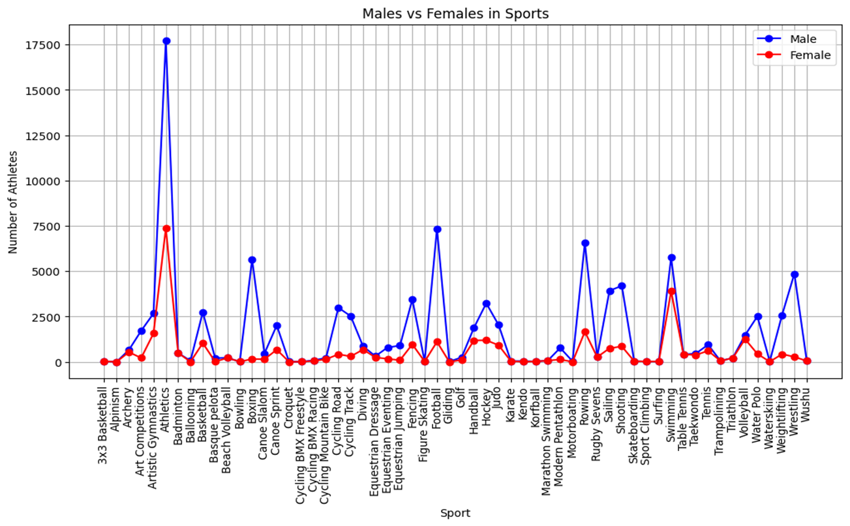
Males vs Females in Sports
Sports played only by men: 'Tug-Of-War' 'American Football' 'Baseball' 'Australian Rules Football' 'Rugby' 'Equestrian Driving' 'Bicycle Polo' 'Motorcycle Sports' 'Canoe Marathon' 'Lacrosse' 'Roque' 'Polo' 'Fishing' 'Ice Hockey' 'Military Exercise' 'Boules' 'Automobile Racing' 'Roller Hockey' 'Cricket' 'Equestrian Vaulting' 'Jeu De Paume' 'Pesäpallo' 'Longue Paume' 'Firefighting' 'Racquets' 'Savate' 'Kaatsen' 'Glíma' 'Lifesaving' 'Canne De Combat' 'Aeronautics’
Sports played only by women: 'Artistic Swimming' 'Rhythmic Gymnastics' 'Softball'

Slide 11
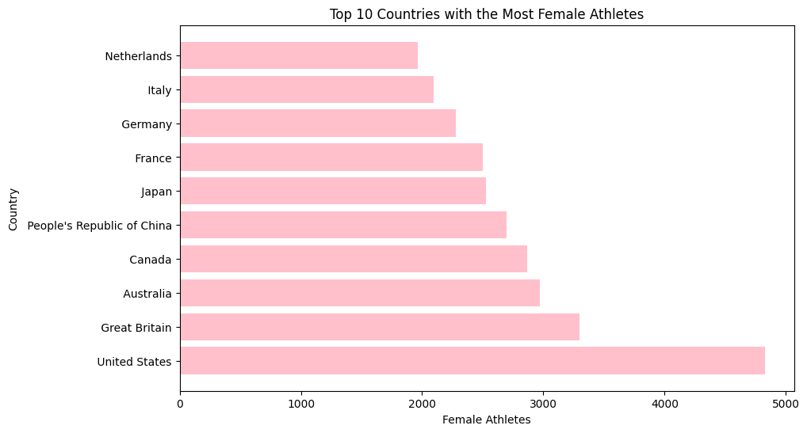
Top 10 Countries

Slide 12

References
https://www.kaggle.com/datasets/muhammadehsan000/olympic-historical-dataset-1896-2020?select=Olympic_Athlete_Bio.csv
Olympic_Athlete_Bio.csv
Olympic_Athlete_Event_Results.csv
Olympic_Games_Medal_Tally.csv
Olympic_Results.csv
Olympics_Country.csv
Olympics_Games.csv
Sport | European Institute for Gender Equality (europa.eu)

